Slide 1

Shiny App for AD Co-Expression Networks
by Michael Riethmüller

Slide 2

Content
Goal
What is Shiny App
Co-Expression Networks
Data
  App features
  KEGG Alzheimer Pathway
  Live Presentation

Slide 3
My Shiny app: Goal
Goal:
Alzheimer Network visualization:
Development of a shiny app to visualize the co-expression network of Alzheimer related genes
The network should show all interactions between genes

Slide 4
What is Shiny App
R Package
install.packages("shiny")
Interactive way to present analysis
Offline useable
Web applications without JavaScript, HTML or CSS

Slide 5
Co-Expression Network
Representation of relationships between genes
Gene expression data e.g RNA-seq, microarrays
Correlation analysis e.g. Pearson or wTO
Network construction
Biological interpretation:
Identify modules/ clusters, candidate disease gene prioritization, functional gene annotation and the identification of regulatory genes

Slide 6
Data
Mayo Clinic Brain Bank
RNA-Seq based whole trancriptome data
All subjects were North American Caucasians >60 years
Clustered with cluster_louvain function of the igraph package
Sex | Male
Age | 63
Braak | 6
PMI | 10,26
RIN | 8,6
Thal | 5
Tissue | Cerebellum

Slide 7
App Features
General information about the co-expression network
Hub genes
Gatekeeper genes
AD KEGG Pathway
Adjustable wTO score
Gene information
Clusters
First neighbour genes

Slide 8
Gatekeeper and Hub Genes
Hub genes have the most connections to other genes
Gatekeeper genes have the highest betweenes score
= how often a node lies on the shortest path between pairs of nodes
Potential key regulators or mediators between genes or between
modules
A gene can be hub and gatekeeper gene

Slide 9
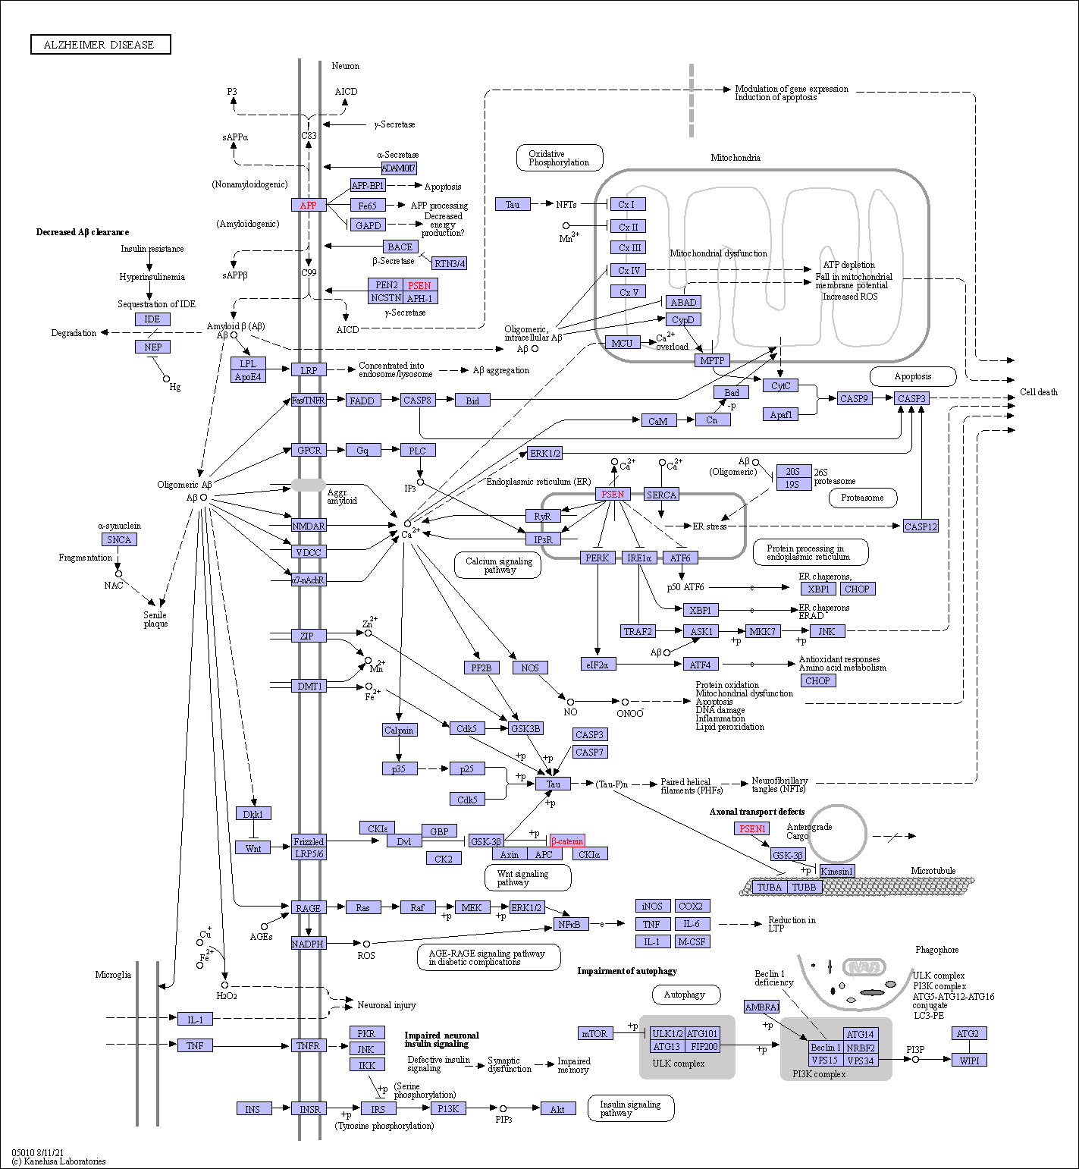
KEGG Alzheimer
Pathway
Kyoto Encyclopedia of Genes
and Genomes
Manually curated diagramm
that represents biological
pathways

Slide 10
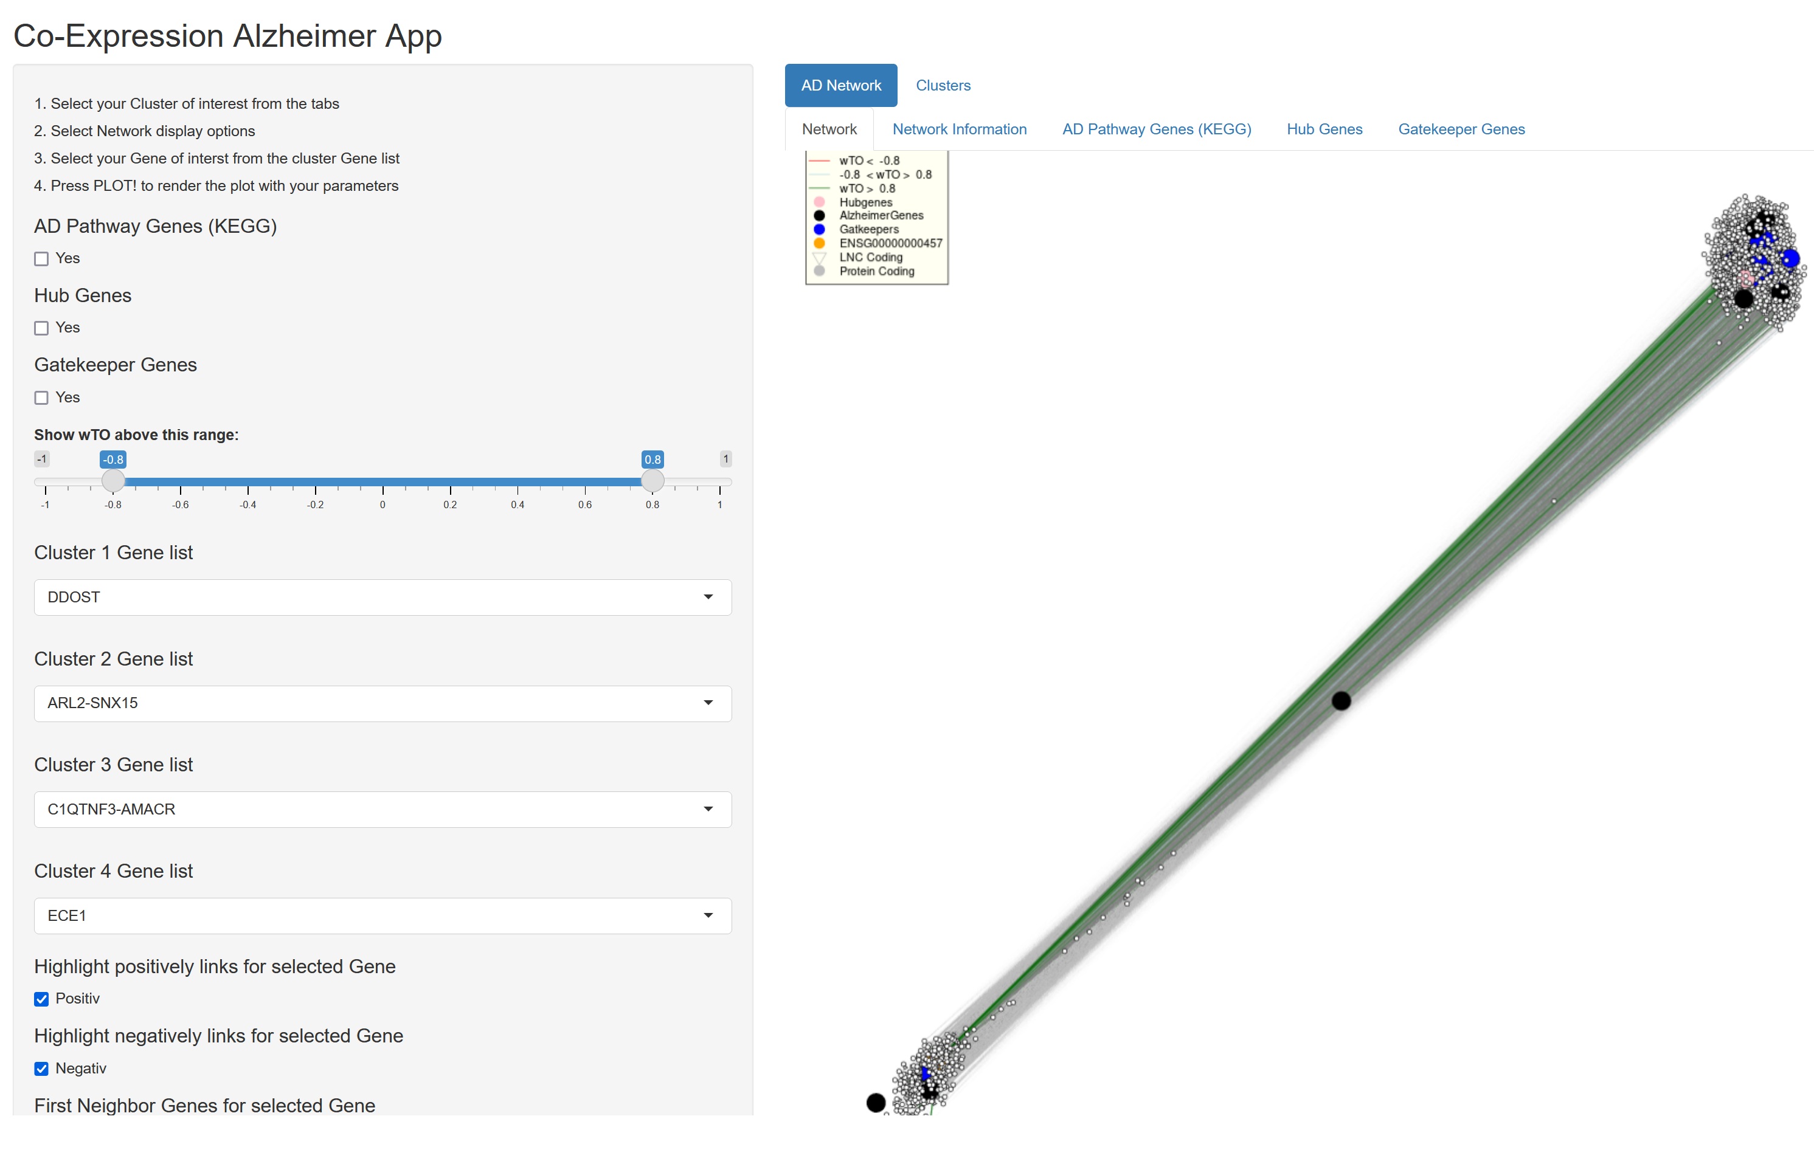

Slide 11
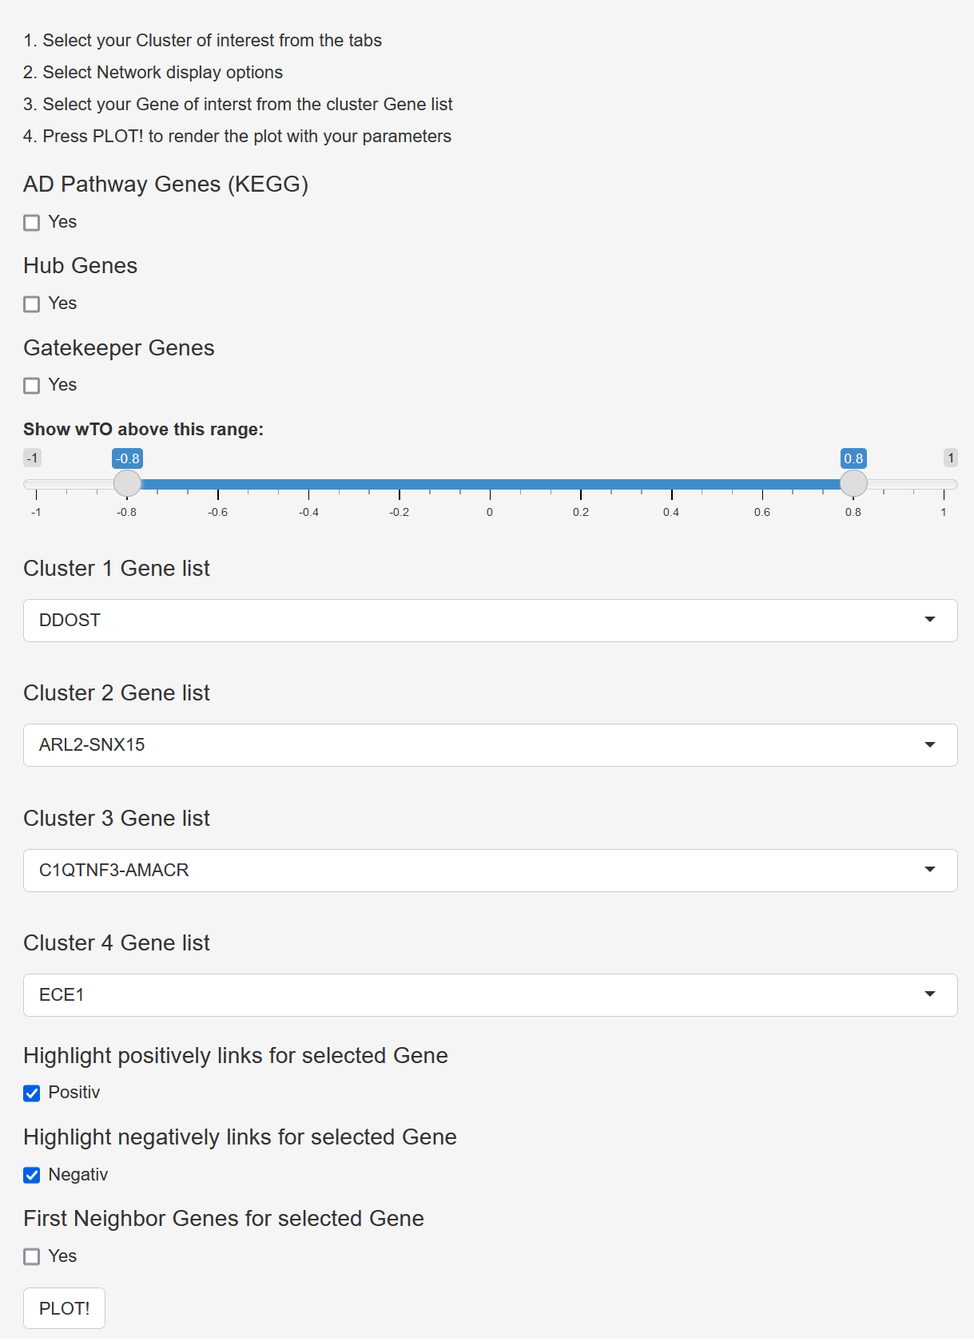
How to use
Select the Cluster of interest form the tabs
Select Network display options
Select your gene of interest from the
cluster gene list
Press PLOT! To render the plot with
your parameters

Slide 12
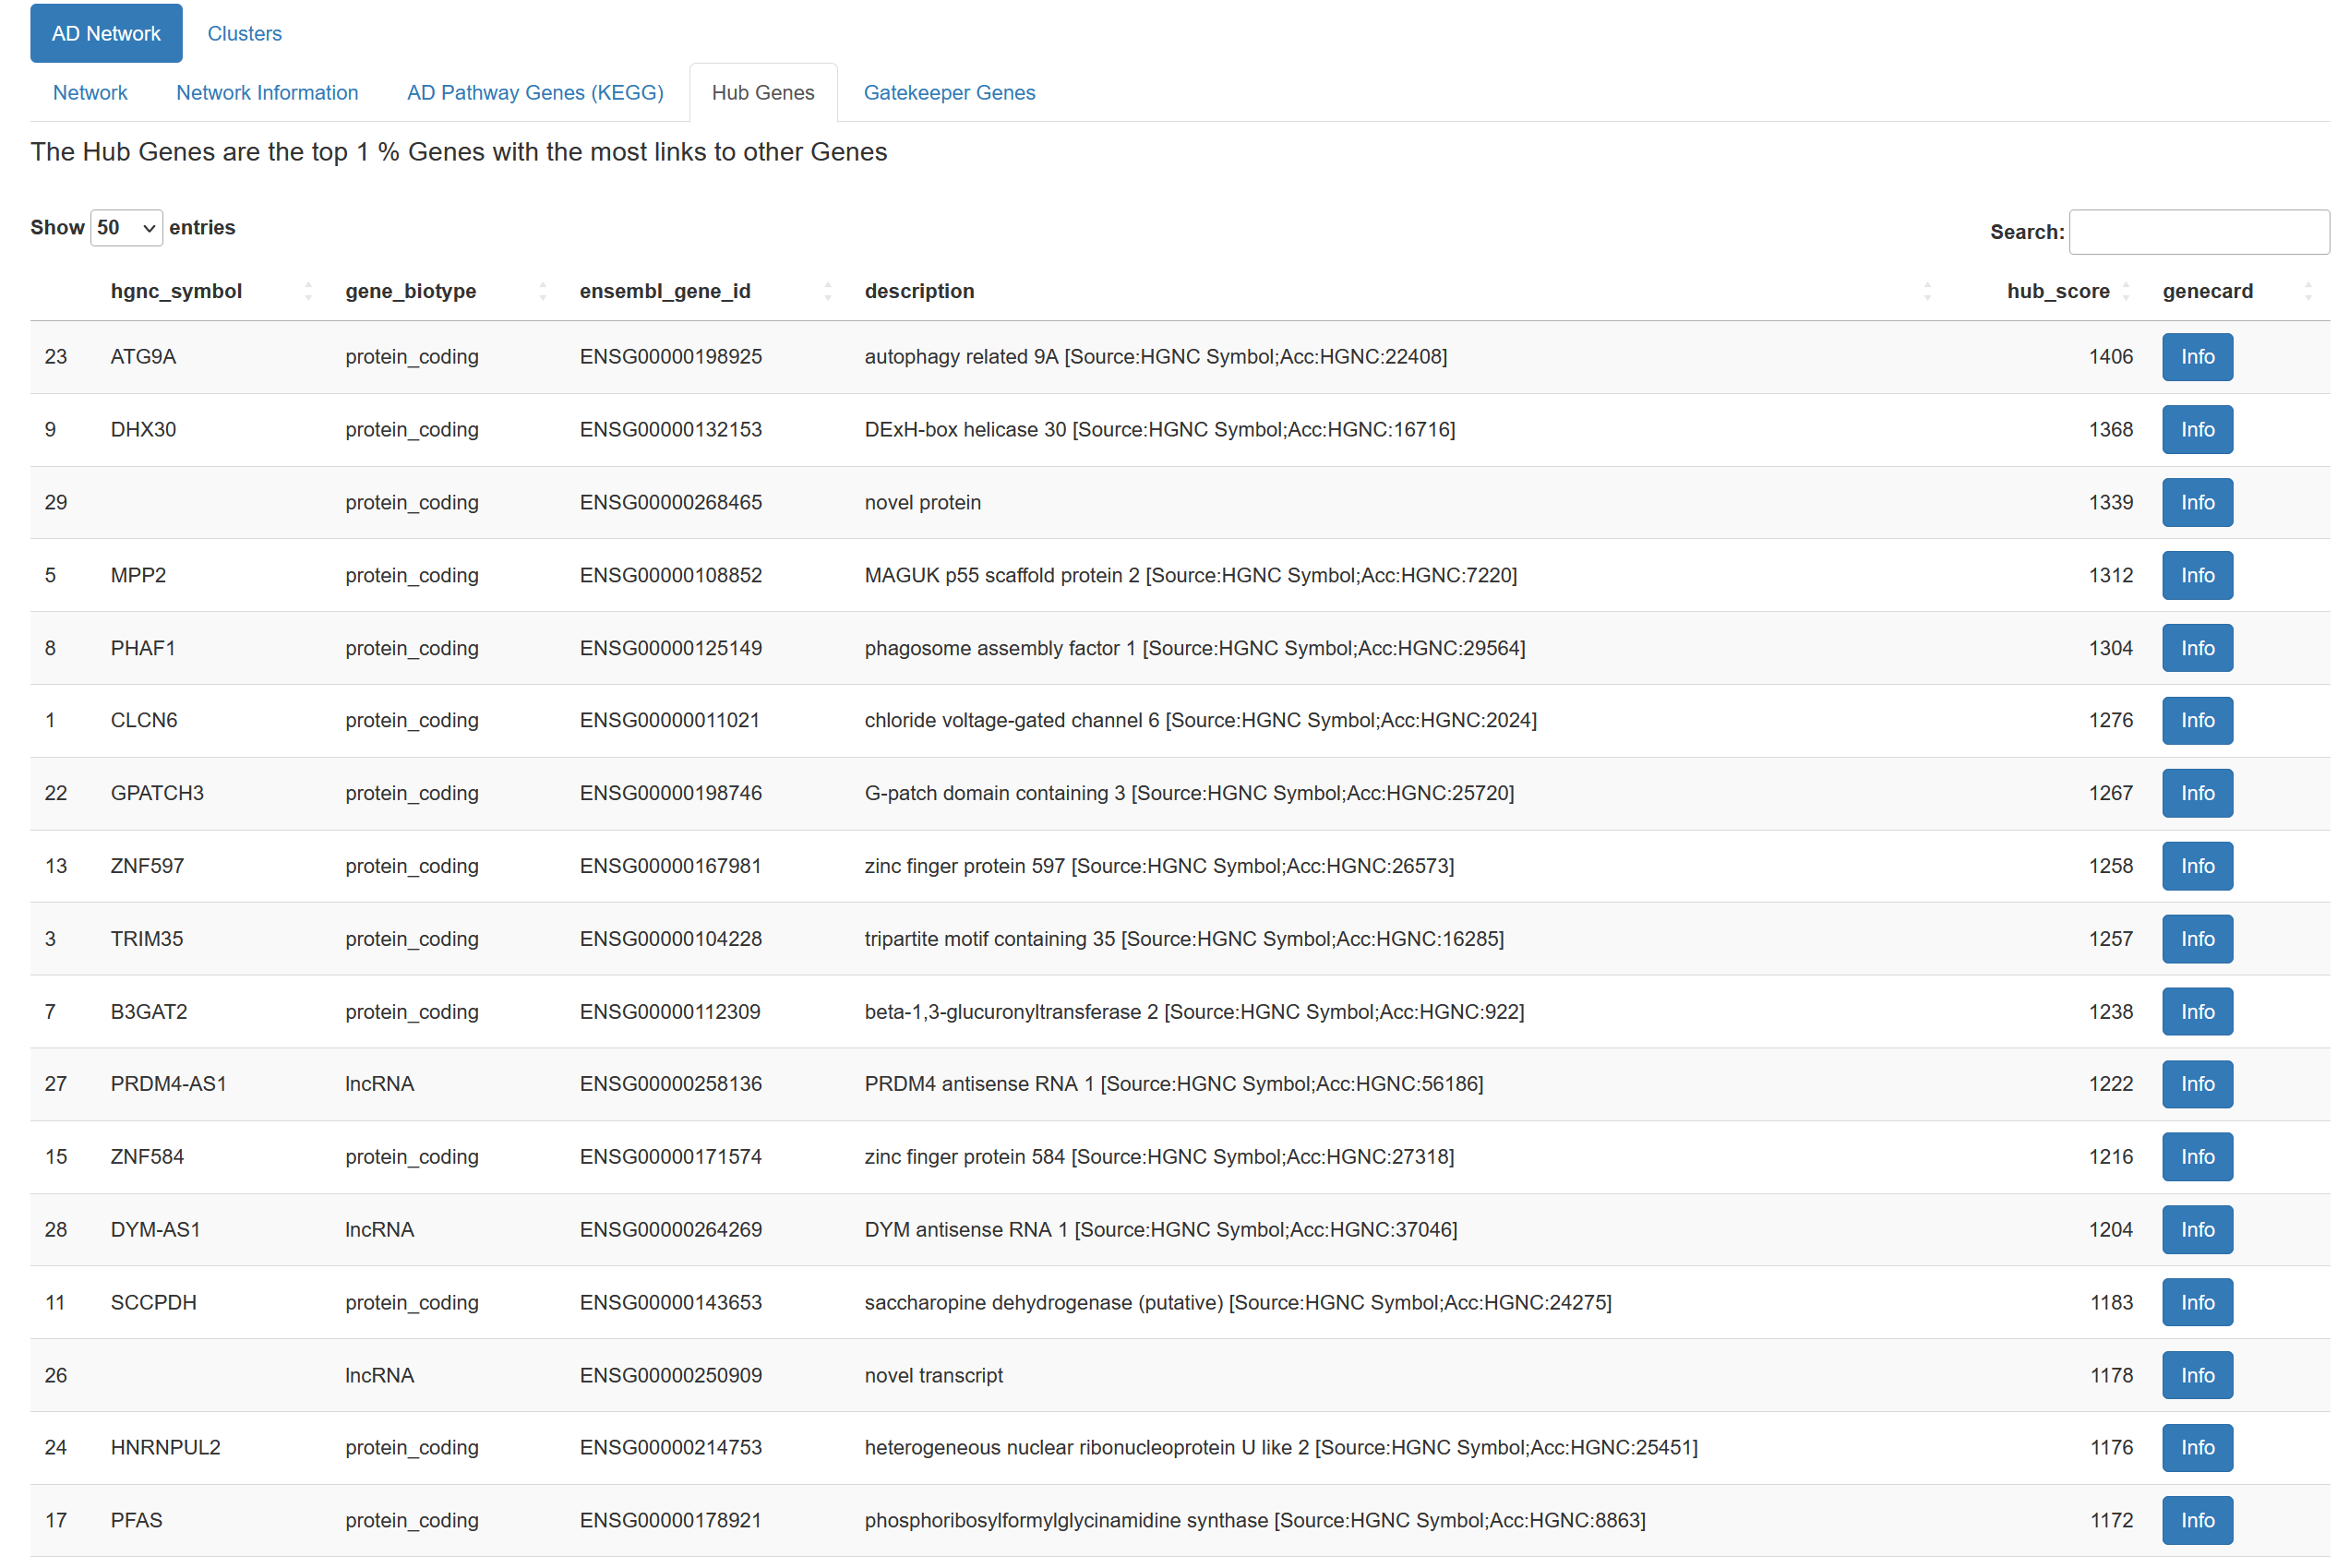
Demonstration
Open Shiny app

Slide 13
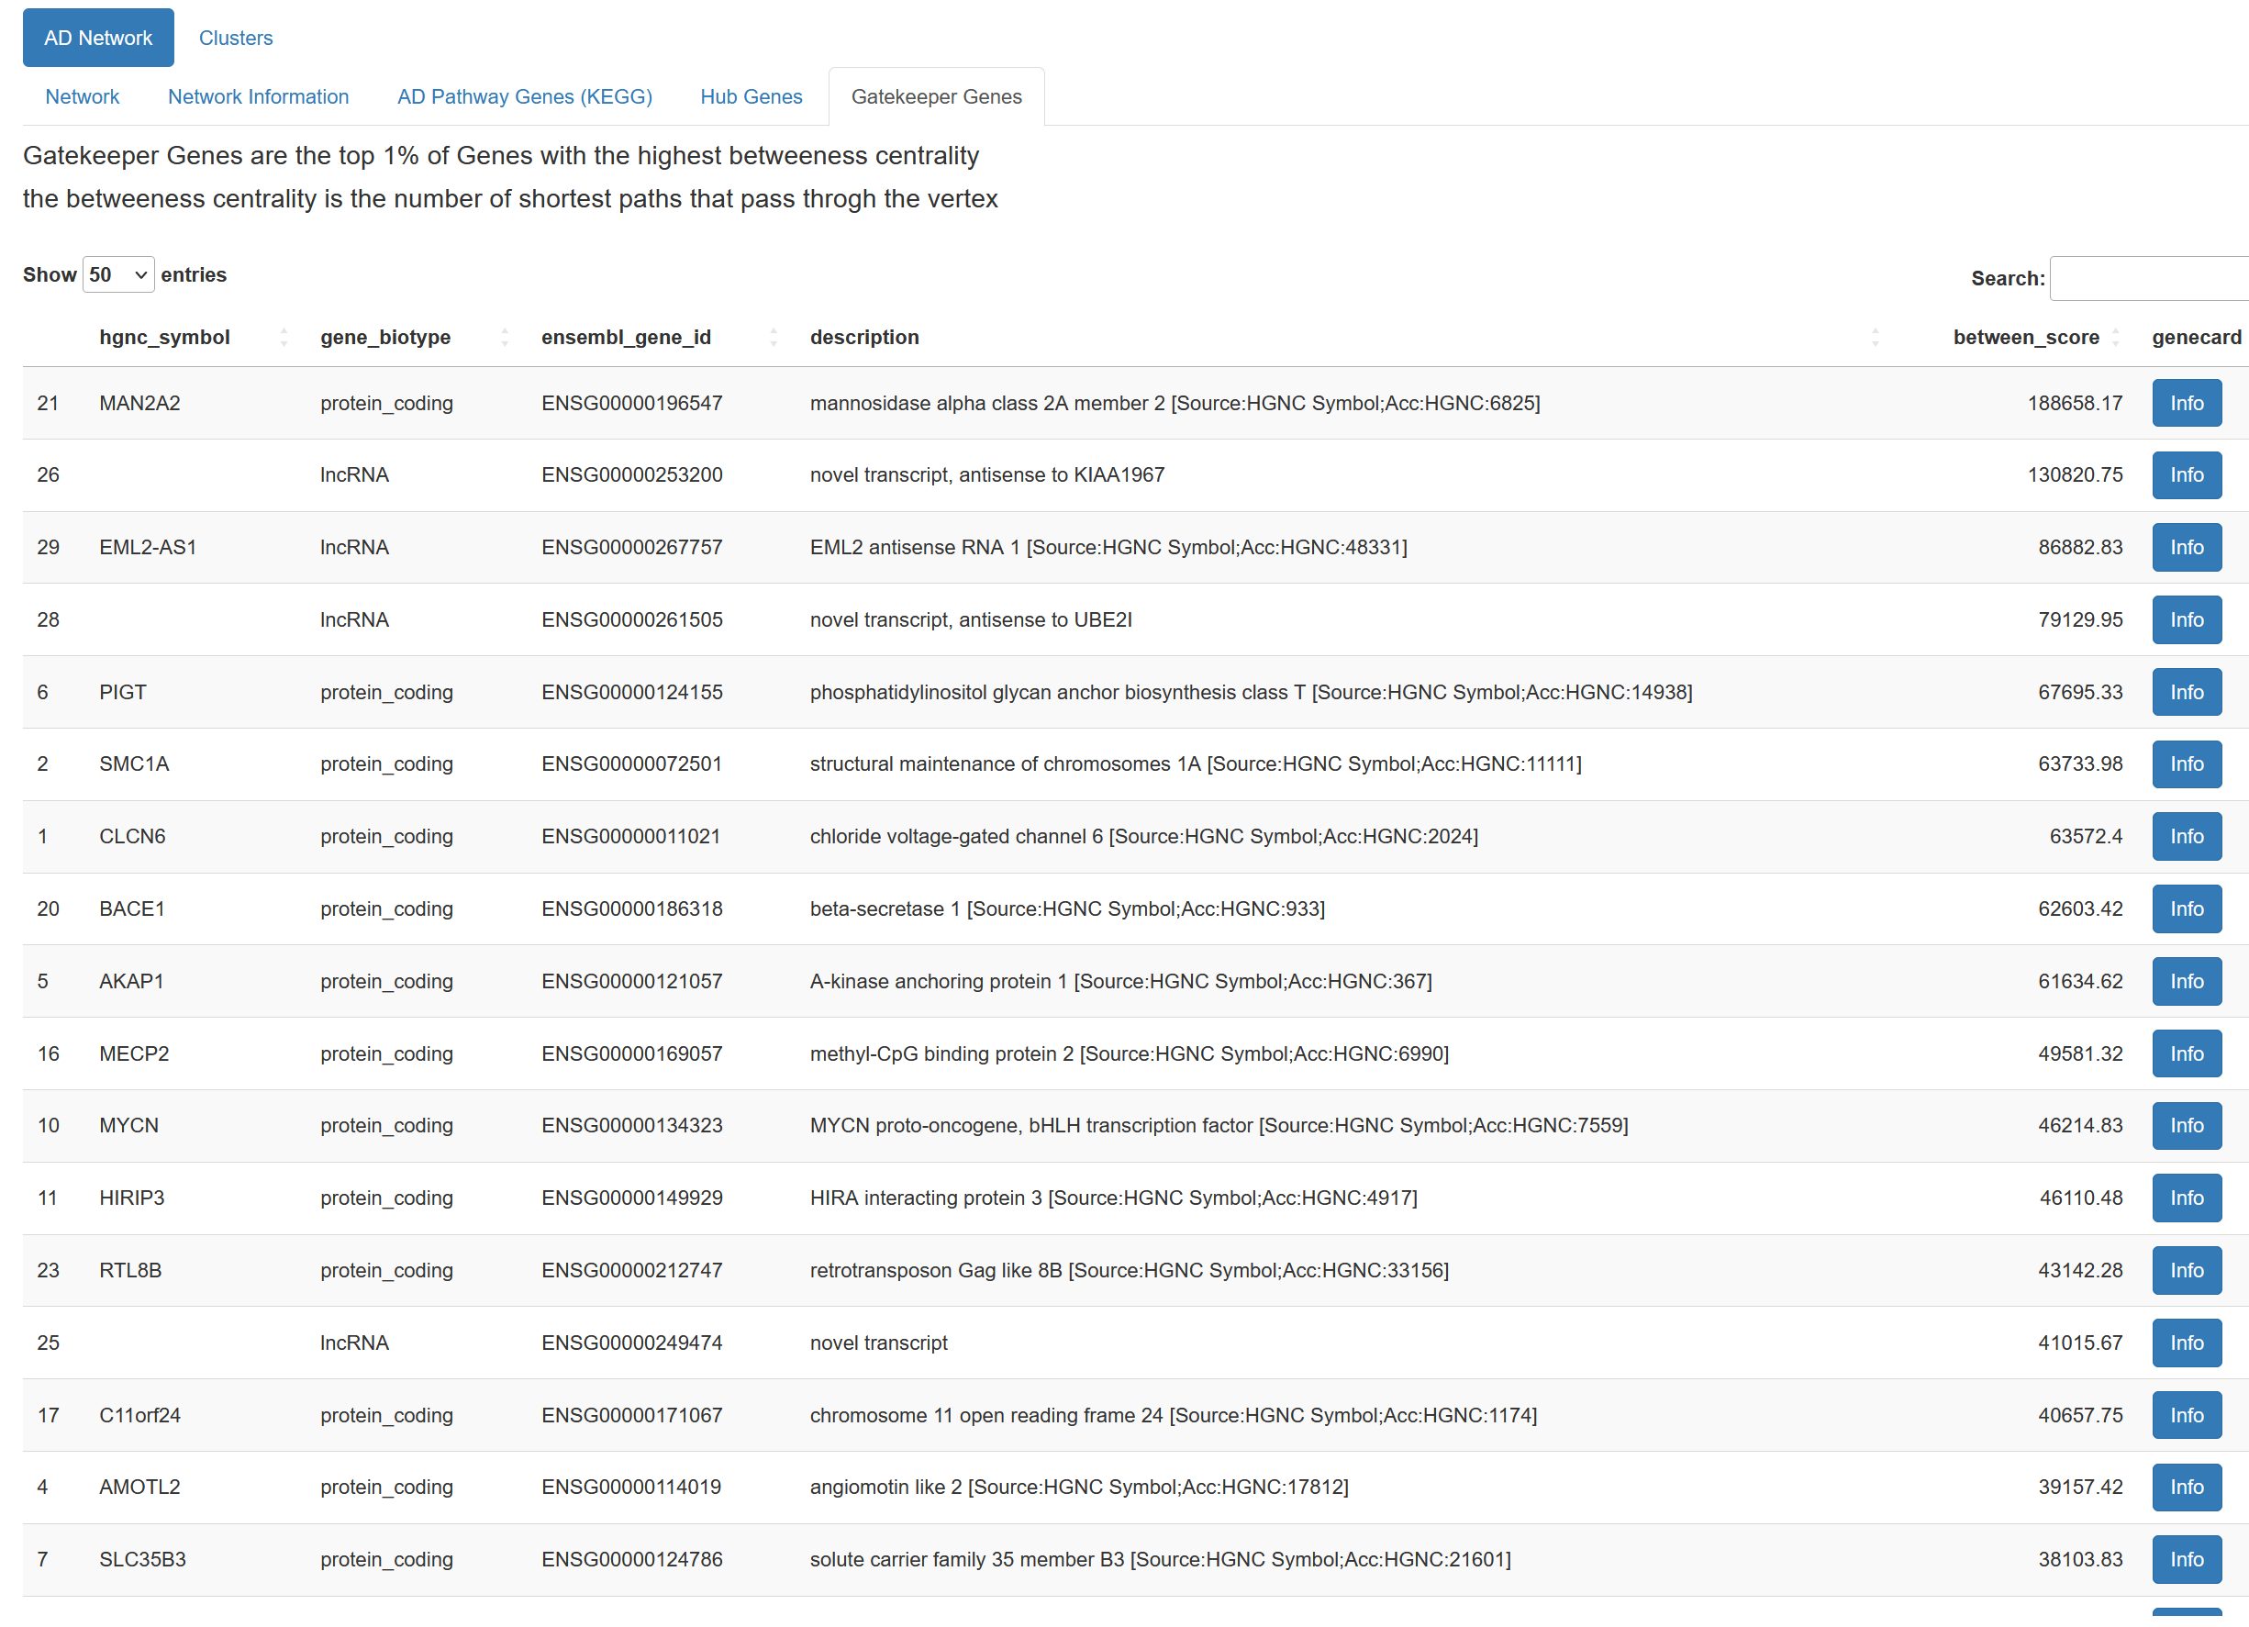

Slide 14
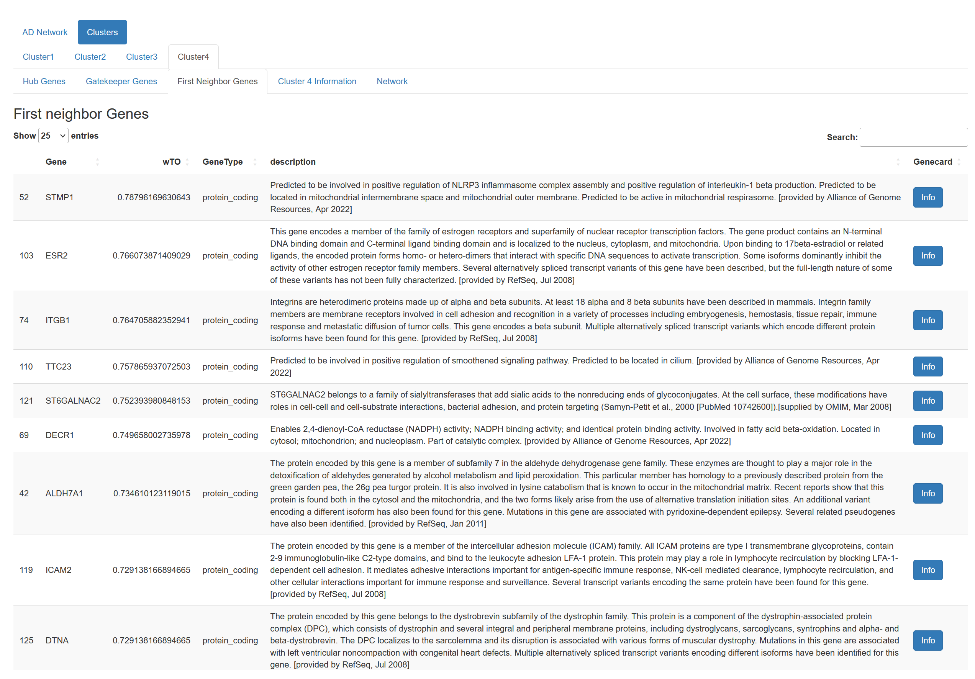

Slide 15
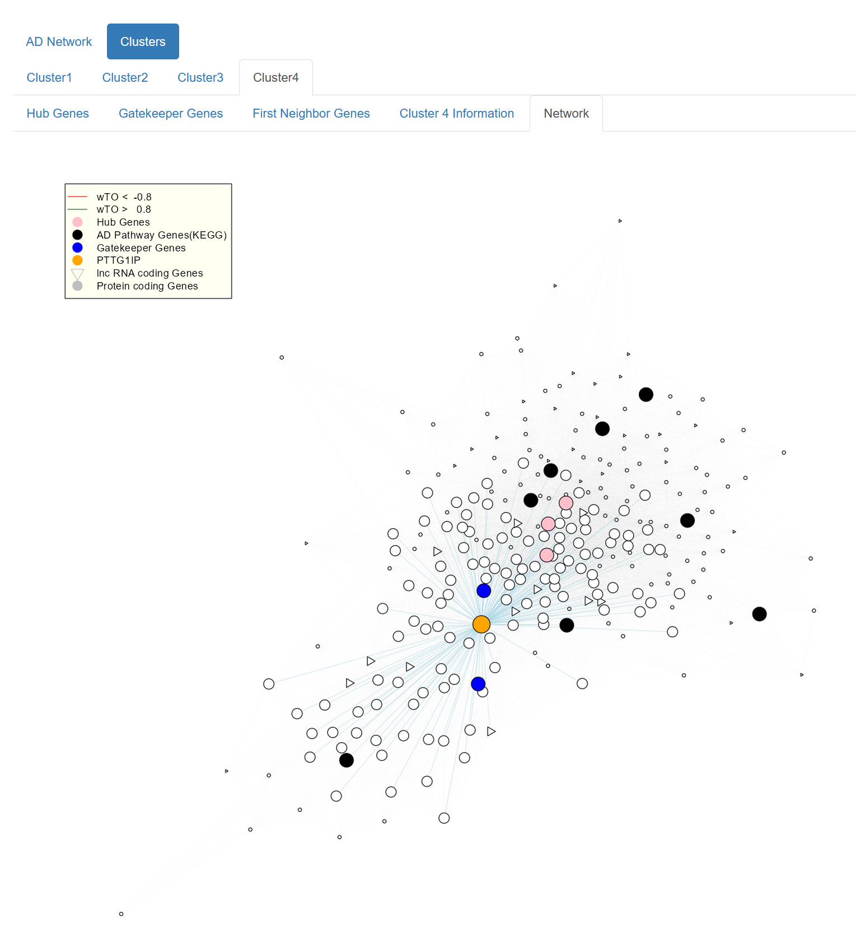

Slide 16
Source
https://www.kegg.jp/kegg-bin/show_pathway?ko05010+K02105
Alzheimer Data: https://pubmed.ncbi.nlm.nih.gov/27727239/
https://pubmed.ncbi.nlm.nih.gov/28077403/

